Slide 1

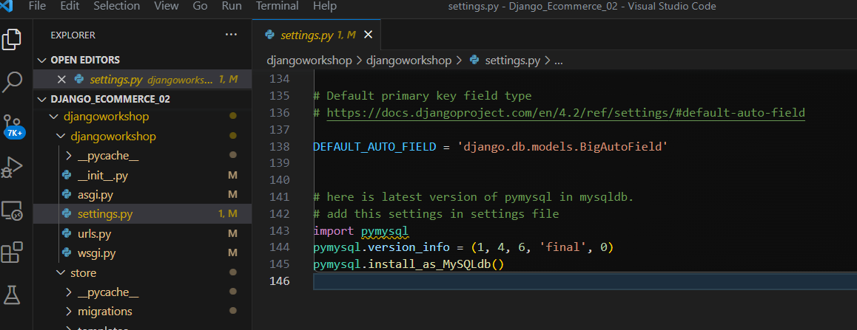
This project run on Dell Computer
The Project run on Dell notebook ( Aug-12-2023)
Database name is Chaison
Found Problem can not see

Slide 2
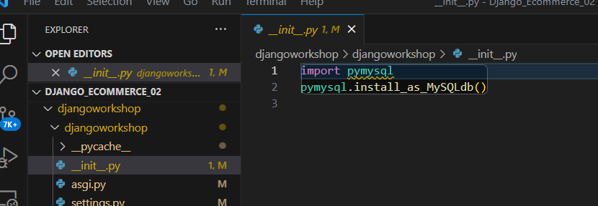

Slide 3
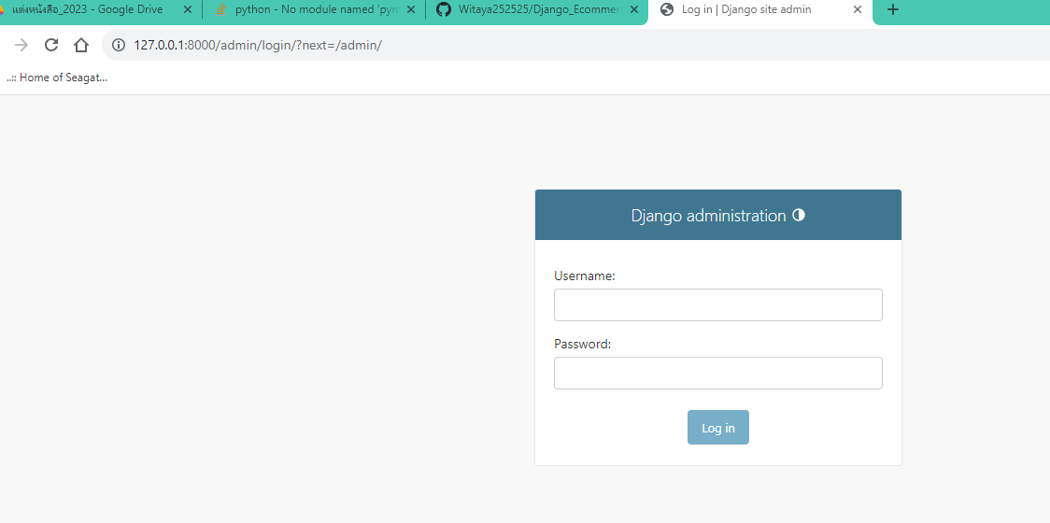
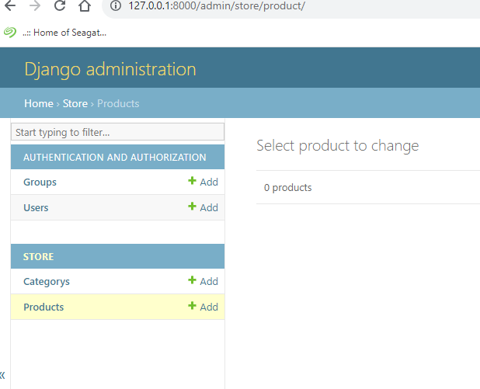
Witaya
339073

Slide 4
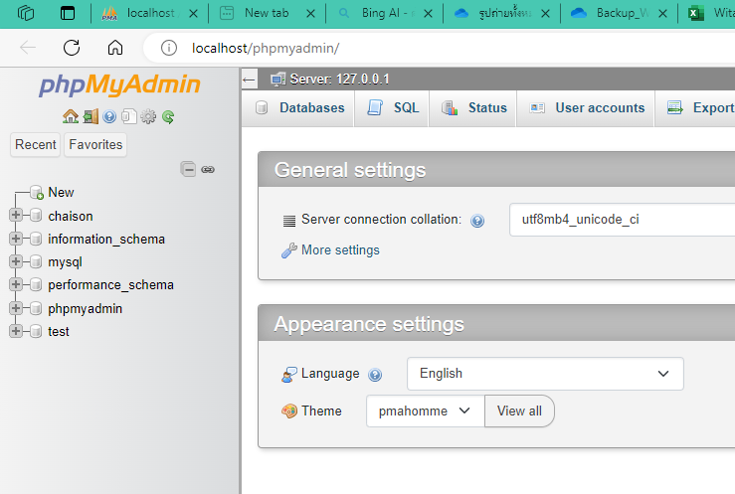

Slide 5
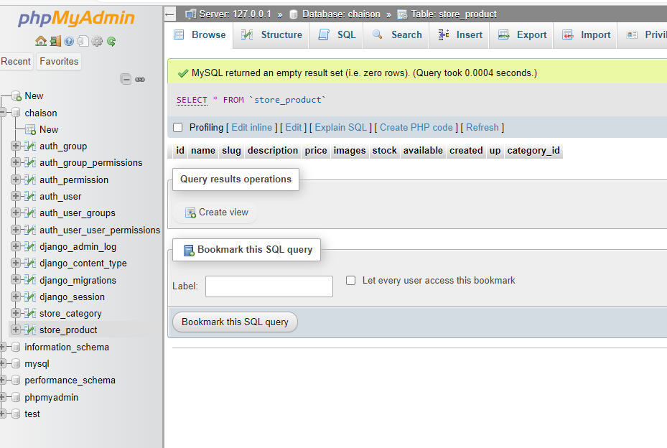

Slide 6
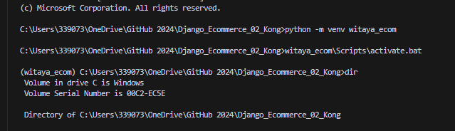
Microsoft Windows [Version 10.0.19045.3208]
(c) Microsoft Corporation. All rights reserved.
C:\Users\339073\OneDrive\WEBDEVELOP2023\Django_Ecommerce_02>python -m venv witaya_ecom
C:\Users\339073\OneDrive\WEBDEVELOP2023\Django_Ecommerce_02>witaya_ecom\Scripts\activate.bat
(witaya_ecom) C:\Users\339073\OneDrive\WEBDEVELOP2023\Django_Ecommerce_02\djangoworkshop>
อย่าลืม เปิด XAMPP ก่อน activate d-jango นะครับ ➔ Jan_08

Slide 7
